Slide 1
Linear Equations in Linear Algebra
VECTOR EQUATIONS

Slide 2


VECTOR EQUATIONS
$$ℝ^{2}$$
Vectors in
A matrix with only one column is called a column vector, or simply a vector.
An example of a vector with two entries is
,
where w₁ and w₂ are any real numbers.
The set of all vectors with 2 entries is denoted by (read “r-two”).
$$ℝ^{2}$$

Slide 3



VECTOR EQUATIONS
The stands for the real numbers that appear as entries in the vector, and the exponent 2 indicates that each vector contains 2 entries.
Two vectors in are equal if and only if their corresponding entries are equal.
Given two vectors u and v in , their sum is the vector obtained by adding corresponding entries of u and v.
Given a vector u and a real number c, the scalar multiple of u by c is the vector cu obtained by multiplying each entry in u by c.
$$ℝ$$
$$ℝ^{2}$$
$$ℝ^{2}$$

Slide 4
VECTOR EQUATIONS
Example 1: Given and , find
, , and .
Solution: , and

Slide 5


GEOMETRIC DESCRIPTIONS OF
$$ℝ^{2}$$
Consider a rectangular coordinate system in the plane. Because each point in the plane is determined by an ordered pair of numbers, we can identify a
geometric point (a, b) with the column vector .
So we may regard as the set of all points in the plane.
$$ℝ^{2}$$

Slide 6
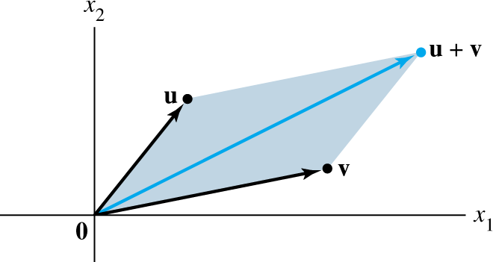

PARALLELOGRAM RULE FOR ADDITION
If u and v in are represented as points in the plane, then corresponds to the fourth vertex of the parallelogram whose other vertices are u, 0, and v. See the figure below.
$$ℝ^{2}$$

Slide 7




VECTORS IN and
$$ℝ^{3}$$
$$ℝ^{n}$$
Vectors in are column matrices with three entries.
They are represented geometrically by points in a three-dimensional coordinate space, with arrows from the origin.
If n is a positive integer, (read “r-n”) denotes the collection of all lists (or ordered n-tuples) of n real numbers, usually written as column matrices, such as
.
$$ℝ^{3}$$
$$ℝ^{n}$$

Slide 8


ALGEBRAIC PROPERTIES OF
$$ℝ^{n}$$
The vector whose entries are all zero is called the zero vector and is denoted by 0.
For all u, v, w in and all scalars c and d:
(i)
(ii)
(iii)
(iv) ,
where denotes
(v)
(vi)
$$ℝ^{n}$$

Slide 9

LINEAR COMBINATIONS
(vii)
(viii)
Given vectors v₁, v₂, ..., v_{p} in and given scalars c₁, c₂, ..., c_{p}, the vector y defined by
is called a linear combination of v₁, …, v_{p} with weights c₁, …, c_{p}.
The weights in a linear combination can be any real numbers, including zero.
$$ℝ^{n}$$

Slide 10
LINEAR COMBINATIONS
Example 2: Let , and .
Determine whether b can be generated (or written) as a linear combination of a₁ and a₂. That is, determine whether weights x₁ and x₂ exist such that
----(1)
If vector equation (1) has a solution, find it.

Slide 11

LINEAR COMBINATIONS
Solution: Use the definitions of scalar multiplication and vector addition to rewrite the vector equation
,
which is same as
.
a₁
a₂
b

Slide 12
LINEAR COMBINATIONS
and
. ----(2)
The vectors on the left and right sides of (2) are equal if and only if their corresponding entries are both equal. That is, x₁ and x₂ make the vector equation (1) true if and only if x₁ and x₂ satisfy the following system.
----(3)

Slide 13
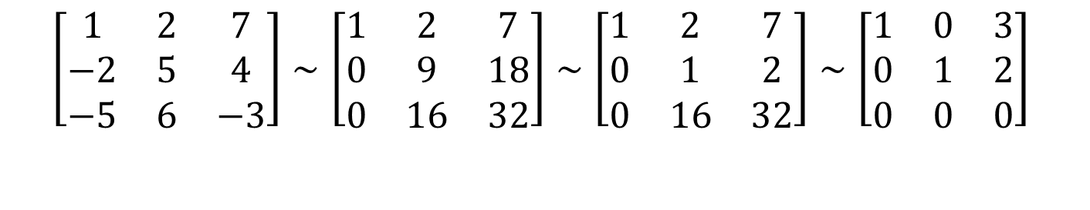
LINEAR COMBINATIONS
To solve this system, row reduce the augmented matrix of the system as follows.
The solution of (3) is and . Hence b is a linear combination of a₁ and a₂, with weights and
. That is,
$$\left[\begin{matrix}1 & 2 & 7 \\ −2 & 5 & 4 \\ −5 & 6 & −3\end{matrix}\right]∼\left[\begin{matrix}1 & 2 & 7 \\ 0 & 9 & 18 \\ 0 & 16 & 32\end{matrix}\right]∼\left[\begin{matrix}1 & 2 & 7 \\ 0 & 1 & 2 \\ 0 & 16 & 32\end{matrix}\right]∼\left[\begin{matrix}1 & 0 & 3 \\ 0 & 1 & 2 \\ 0 & 0 & 0\end{matrix}\right]$$

Slide 14
LINEAR COMBINATIONS
Now, observe that the original vectors a₁, a₂, and b are the columns of the augmented matrix that we row reduced:
Write this matrix in a way that identifies its columns.
----(4)
a₁
a₂
b

Slide 15
LINEAR COMBINATIONS
A vector equation
has the same solution set as the linear system whose augmented matrix is
. ----(5)
In particular, b can be generated by a linear combination of a₁, …, a_{n} if and only if there exists a solution to the linear system corresponding to the matrix (5).

Slide 16


LINEAR COMBINATIONS
Definition: If v₁, …, v_{p} are in , then the set of all linear combinations of v₁, …, v_{p} is denoted by Span {v₁, …, v_{p}} and is called the subset of spanned (or generated) by v₁, …, v_{p}. That is, Span {v₁, ..., v_{p}} is the collection of all vectors that can be written in the form
with c₁, …, c_{p} scalars.
$$ℝ^{n}$$
$$ℝ^{n}$$

Slide 17
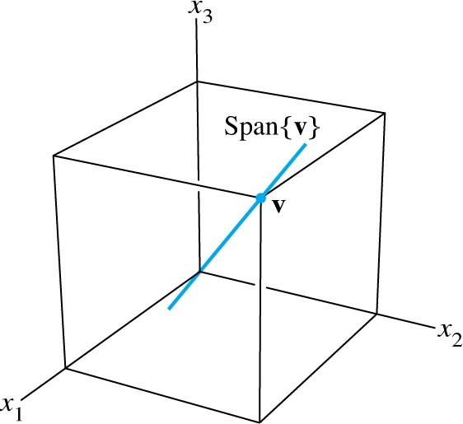


A GEOMETRIC DESCRIPTION OF SPAN {V}
Let v be a nonzero vector in . Then Span {v} is the set of all scalar multiples of v, which is the set of points on the line in through v and 0. See the figure below.
$$ℝ^{3}$$
$$ℝ^{3}$$

Slide 18
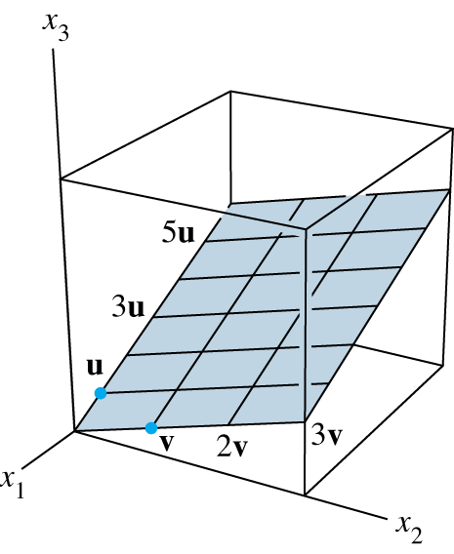



A GEOMETRIC DESCRIPTION OF SPAN {U, V}
If u and v are nonzero vectors in , with v not a multiple of u, then Span {u, v} is the plane in that contains u, v, and 0.
In particular, Span {u, v} contains the line in through u and 0 and the line through v and 0. See the figure below.
$$ℝ^{3}$$
$$ℝ^{3}$$
$$ℝ^{3}$$

